Slide 1
QUIZ Arranged by QBE
Notes:
Create a name for your quiz and list names of volunteers running this.
‘Quiz masters’ should introduce themselves to everyone and complete a round of introductions from the quiz participants.

Slide 2
QUIZ Rounds
Round one: Treasure Hunt
Round two: At the beach
Round three: Animals
Round four: Sounds
Round five: Seasons
Notes:
This gives a clear layout for the quiz so participants are aware of what to expect.
Please include the themes or what type of questions will be included in each round (e.g. geography, anagrams, numbers round etc)

Slide 3
Round one : Treasure Hunt
Find something in your house that is….
A circle
Yellow
A square
1.
2.
3.
Green
A cylinder
Orange
4.
5.
6.
Notes:
Please insert photos for the first round of the quiz. It is best to choose a theme around this (e.g. animals, flags, famous musicians etc)
The first round should last around 5 minutes.

Slide 4
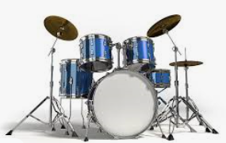
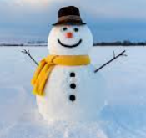
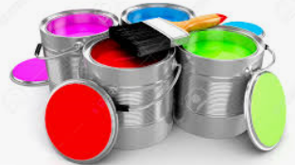
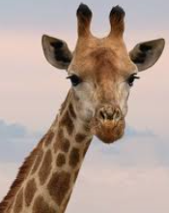
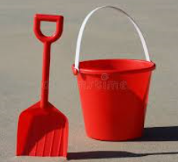
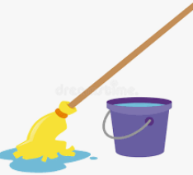
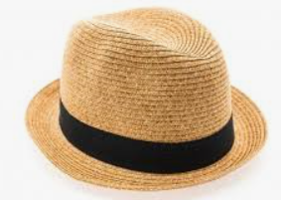
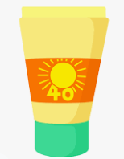
Round two : At the beach
What things will I need to take to the beach?
Notes:
Please add the theme to the header of the quiz.
You should aim to have around 5 minutes for each round so please consider this for when thinking of questions for the quiz. Try to vary the difficulty level of questions to make it more interesting for participants.
Ask participants if they would like you to repeat any questions from this round.

Slide 5
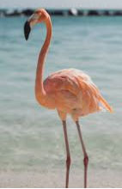
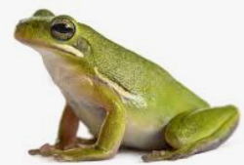
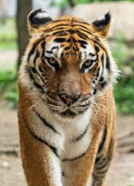
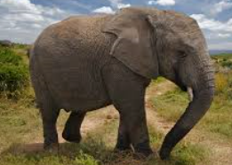
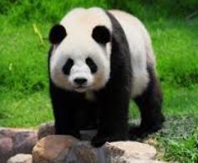
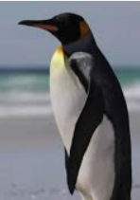
Round three : Animals
Match pictures with the list of animals below:
A.
B.
C.
Penguin
Tiger
Elephant
Panda
Flamingo
Frog
D.
E.
F.
Notes:
Please add the theme to the header of the quiz.
You should aim to have around 5 minutes for each round so consider this for when thinking of questions for the quiz. Try to vary the difficulty level of questions to make it more interesting for participants.
Ask participants if they would like you to repeat any questions from this round.

Slide 6
Round four : Sounds
Match each sound with the correct instrument
1.
2.
3.
c
Guitar
Triangle
Trumpet
Piano
Flute
Violin
4.
5.
6.
Notes:
Please add the theme to the header of the quiz.
You should aim to have around 5 minutes for each round so consider this for when thinking of questions for the quiz. Try to vary the difficulty level of questions to make it more interesting for participants.
Ask participants if they would like you to repeat any questions from this round.

Slide 7
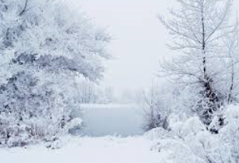
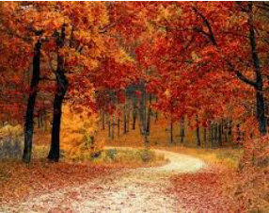
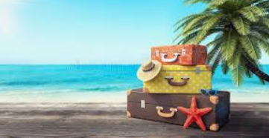
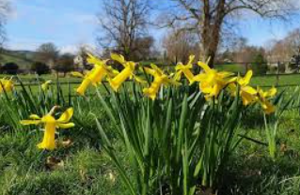
Round five: Seasons
Match the pictures with the names of the seasons:
1.
2.
Spring
Summer
Autumn
Winter
3.
4.
Notes:
Please add the theme to the header of the quiz.
You should aim to have around 5 minutes for each round so consider this for when thinking of questions for the quiz. Try to vary the difficulty level of questions to make it more interesting for participants.
Ask participants if they would like you to repeat any questions from this round.
Once you have run through all of the questions, go to Slide 4 to reveal the answers to the groups. Encourage people to shout out the answers or write them in the chat before you confirm the answers.
When you have gone through all of the question ask participants to add up their scores, read them out one by one (or in the chat box) so you can reveal the winner!

Slide 8
Answers
Round two: At the beach
Sunglasses, water, bucket and spade, sun hat, suntan lotion
Round three: Animals
1 & F
2 & C
3 & D
4 & E
5 & A
6 & B
Notes:
Please add the theme to the header of the quiz.
You should aim to have around 5 minutes for each round so consider this for when thinking of questions for the quiz. Try to vary the difficulty level of questions to make it more interesting for participants.
Ask participants if they would like you to repeat any questions from this round.
Once you have run through all of the questions, go to Slide 4 to reveal the answers to the groups. Encourage people to shout out the answers or write them in the chat before you confirm the answers.
When you have gone through all of the question ask participants to add up their scores, read them out one by one (or in the chat box) so you can reveal the winner!

Slide 9
Answers
Round four: Sounds
1 & C
2 & D
3 & E
4 & A
5 & F
6 & B
Round 5: Seasons
1 & D
2 & C
3 & B
4 & A
Notes:
Please add the theme to the header of the quiz.
You should aim to have around 5 minutes for each round so consider this for when thinking of questions for the quiz. Try to vary the difficulty level of questions to make it more interesting for participants.
Ask participants if they would like you to repeat any questions from this round.
Once you have run through all of the questions, go to Slide 4 to reveal the answers to the groups. Encourage people to shout out the answers or write them in the chat before you confirm the answers.
When you have gone through all of the question ask participants to add up their scores, read them out one by one (or in the chat box) so you can reveal the winner!

Slide 10
Thank you for participating! ☺

