Slide 1
Play Time! Arranged by QBE
Notes:
Create a name for your quiz and list names of volunteers running this.
‘Quiz masters’ should introduce themselves to everyone and complete a round of introductions from the quiz participants.

Slide 2
QUIZ Rounds
Round one: Pairs
Round two: Sounds
Round three: Copy me
Round four: My senses
Round five: Opposites
Notes:
This gives a clear layout for the quiz so participants are aware of what to expect.
Please include the themes or what type of questions will be included in each round (e.g. geography, anagrams, numbers round etc)

Slide 3
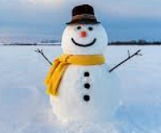
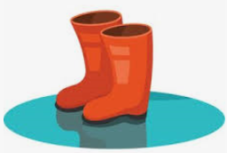
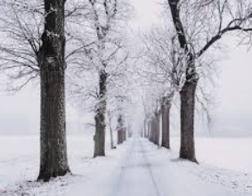
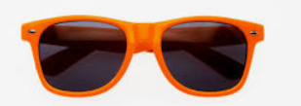
Round one : Pairs
Match each picture with their pair:
1.
2.
3.
4.
5.
6.
Notes:
Please insert photos for the first round of the quiz. It is best to choose a theme around this (e.g. animals, flags, famous musicians etc)
The first round should last around 5 minutes.

Slide 4
Round two : Sounds
Play each of the videos and make the same sounds as the animals:
1.
2.
3.
4.
5.
6.
Notes:
Please add the theme to the header of the quiz.
You should aim to have around 5 minutes for each round so please consider this for when thinking of questions for the quiz. Try to vary the difficulty level of questions to make it more interesting for participants.
Ask participants if they would like you to repeat any questions from this round.

Slide 5
Round three : Copy me
Play each video and make the same sounds.
1.
2.
3.
Notes:
Please add the theme to the header of the quiz.
You should aim to have around 5 minutes for each round so consider this for when thinking of questions for the quiz. Try to vary the difficulty level of questions to make it more interesting for participants.
Ask participants if they would like you to repeat any questions from this round.

Slide 6
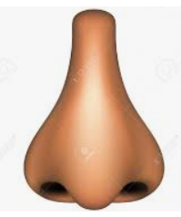
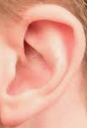
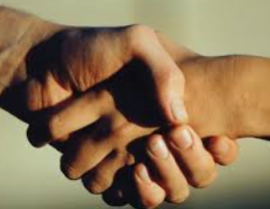
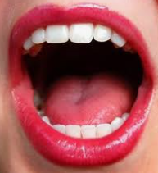
Round four : My senses
You have 5 senses. Point to each one:
Nose
Eyes
Ears
Hands
Mouth
Smell
Sight
Hearing
Touch
Taste
Notes:
Please add the theme to the header of the quiz.
You should aim to have around 5 minutes for each round so consider this for when thinking of questions for the quiz. Try to vary the difficulty level of questions to make it more interesting for participants.
Ask participants if they would like you to repeat any questions from this round.

Slide 7
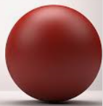
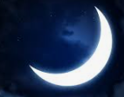
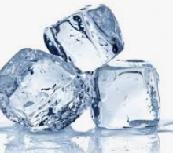
Round five: Opposites
Match each picture with their opposite:
1.
2.
3.
4.
5.
6.
7.
8.
Notes:
Please add the theme to the header of the quiz.
You should aim to have around 5 minutes for each round so consider this for when thinking of questions for the quiz. Try to vary the difficulty level of questions to make it more interesting for participants.
Ask participants if they would like you to repeat any questions from this round.
Once you have run through all of the questions, go to Slide 4 to reveal the answers to the groups. Encourage people to shout out the answers or write them in the chat before you confirm the answers.
When you have gone through all of the question ask participants to add up their scores, read them out one by one (or in the chat box) so you can reveal the winner!

Slide 8
Answers
Round 1 – Pairs:
1 & 5
2 & 6
3 & 4
Round 5 – Opposites
1 & 7
2 & 8
3 & 6
4 & 5

Slide 9
Thank you for participating! ☺

