Slide 1
QUIZ Arranged by QBE
Notes:
Create a name for your quiz and list names of volunteers running this.
‘Quiz masters’ should introduce themselves to everyone and complete a round of introductions from the quiz participants.

Slide 2
QUIZ Rounds
Round one: Guess the location
Round two: Music
Round three: General knowledge
Round four: Name the product
Round five: TV & film
Notes:
This gives a clear layout for the quiz so participants are aware of what to expect.
Please include the themes or what type of questions will be included in each round (e.g. geography, anagrams, numbers round etc)

Slide 3
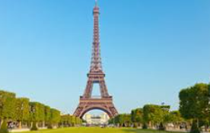
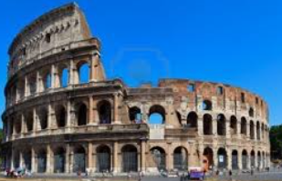
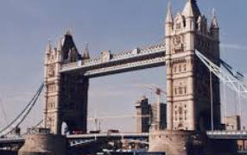
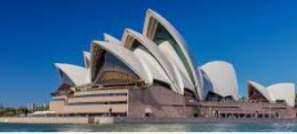
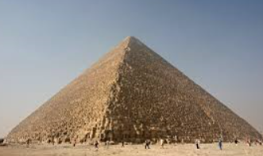
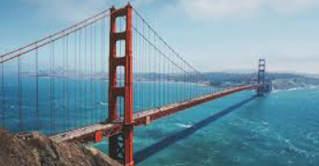
Round one : Guess the country
Guess the country where each landmark is located:
1.
2.
3.
4.
5.
6.
Notes:
Please insert photos for the first round of the quiz. It is best to choose a theme around this (e.g. animals, flags, famous musicians etc)
The first round should last around 5 minutes.

Slide 4
Round two : Music
In what year were these songs released?
1.
2.
3.
4.
5.
6.
Notes:
Please add the theme to the header of the quiz.
You should aim to have around 5 minutes for each round so please consider this for when thinking of questions for the quiz. Try to vary the difficulty level of questions to make it more interesting for participants.
Ask participants if they would like you to repeat any questions from this round.

Slide 5
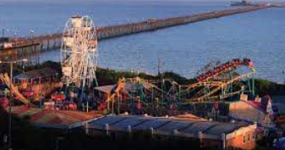
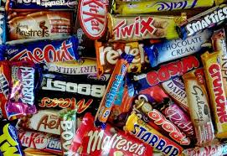
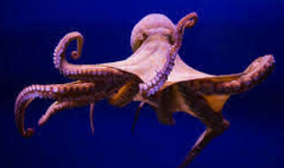
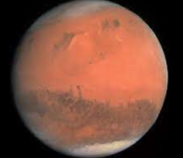
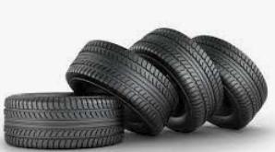
Round three : General knowledge
1. Which English seaside town has the longest pleasure pier in the world?
2. In 2020 what was named the UK’s favourite chocolate bar?
3. How many hearts does an octopus have?
4. Which manufacturer holds the record for the most tyres produced in a single year?
5. What football team are the current holders of the English Premier League?
6. What planet is known as the Red Planet?
Notes:
Please add the theme to the header of the quiz.
You should aim to have around 5 minutes for each round so consider this for when thinking of questions for the quiz. Try to vary the difficulty level of questions to make it more interesting for participants.
Ask participants if they would like you to repeat any questions from this round.

Slide 6
Round four : Name the product
Name the product associated with each logo:
1.
2.
3.
4.
5.
6.
Notes:
Please add the theme to the header of the quiz.
You should aim to have around 5 minutes for each round so consider this for when thinking of questions for the quiz. Try to vary the difficulty level of questions to make it more interesting for participants.
Ask participants if they would like you to repeat any questions from this round.

Slide 7
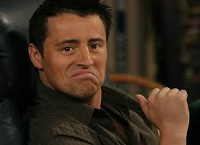
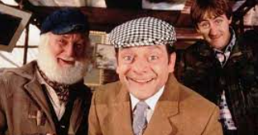
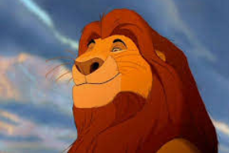
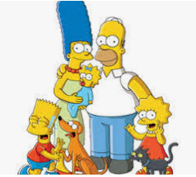
Round five: TV & Film
1. Which American television series do you know this person from?
2 . What is the name of the tower block where Dell Boy and Rodney live?
3. Name the actor who voiced Mufasa in The Lion King.
5. Name Homer Simpson’s youngest daughter.
6. How many Oscars did Titanic win?
4. Name the movie.
Notes:
Please add the theme to the header of the quiz.
You should aim to have around 5 minutes for each round so consider this for when thinking of questions for the quiz. Try to vary the difficulty level of questions to make it more interesting for participants.
Ask participants if they would like you to repeat any questions from this round.
Once you have run through all of the questions, go to Slide 4 to reveal the answers to the groups. Encourage people to shout out the answers or write them in the chat before you confirm the answers.
When you have gone through all of the question ask participants to add up their scores, read them out one by one (or in the chat box) so you can reveal the winner!

Slide 8
Answers
Round one: Guess the country
France
Italy
UK
Australia
USA
Egypt
Round two: Music
2011
2013
2012
2014
2017
2016
Notes:
Please add the theme to the header of the quiz.
You should aim to have around 5 minutes for each round so consider this for when thinking of questions for the quiz. Try to vary the difficulty level of questions to make it more interesting for participants.
Ask participants if they would like you to repeat any questions from this round.
Once you have run through all of the questions, go to Slide 4 to reveal the answers to the groups. Encourage people to shout out the answers or write them in the chat before you confirm the answers.
When you have gone through all of the question ask participants to add up their scores, read them out one by one (or in the chat box) so you can reveal the winner!

Slide 9
Answers
Round three: General knowledge
Southend-on-Sea
Snickers
Three
Lego
Liverpool FC
Mars
Round four: Name the product
7up
McCoy’s
Guinness
Capri-Sun
After Eight
Pringles

Slide 10
Answers
Round five: TV & Film
Friends
Nelson Mandela House
James Earl Jones
Men In Black
Maggie
11
Notes:
Please add the theme to the header of the quiz.
You should aim to have around 5 minutes for each round so consider this for when thinking of questions for the quiz. Try to vary the difficulty level of questions to make it more interesting for participants.
Ask participants if they would like you to repeat any questions from this round.
Once you have run through all of the questions, go to Slide 4 to reveal the answers to the groups. Encourage people to shout out the answers or write them in the chat before you confirm the answers.
When you have gone through all of the question ask participants to add up their scores, read them out one by one (or in the chat box) so you can reveal the winner!

Slide 11
Thank you for participating! ☺

