Slide 1
QUIZ Arranged by QBE
Notes:
Create a name for your quiz and list names of volunteers running this.
‘Quiz masters’ should introduce themselves to everyone and complete a round of introductions from the quiz participants.

Slide 2
QUIZ Rounds
Round one: Music
Round two: Geography
Round three: Brands
Round four: Guess the show
Round five: Sports
Notes:
This gives a clear layout for the quiz so participants are aware of what to expect.
Please include the themes or what type of questions will be included in each round (e.g. geography, anagrams, numbers round etc)

Slide 3
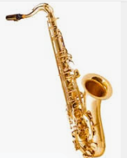
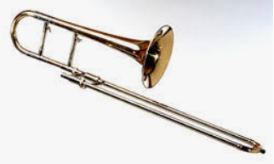
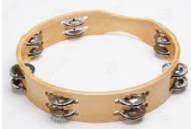
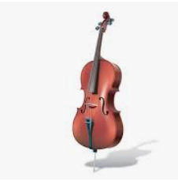
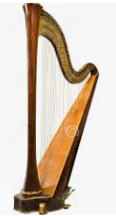
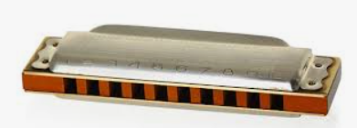
Round one : Music
Name each of these instruments:
1.
2.
3.
4.
5.
6.
Notes:
Please insert photos for the first round of the quiz. It is best to choose a theme around this (e.g. animals, flags, famous musicians etc)
The first round should last around 5 minutes.

Slide 4
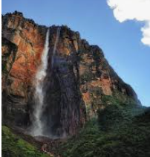
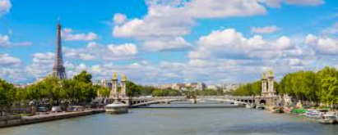
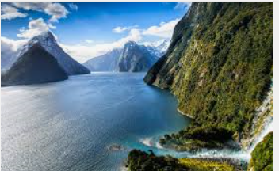
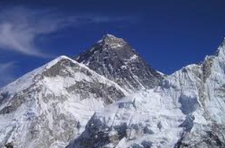
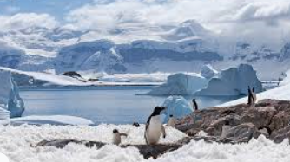
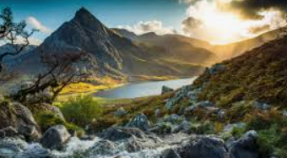
Round two : Geography
1. In which country is the world’s highest waterfall?
2. Name the largest river that runs through Paris.
3. What is the capital of New Zealand?
4. What is the highest mountain in the world?
5. On which continent would you find the South Pole?
5. How many National Parks are there in Wales?
Notes:
Please add the theme to the header of the quiz.
You should aim to have around 5 minutes for each round so please consider this for when thinking of questions for the quiz. Try to vary the difficulty level of questions to make it more interesting for participants.
Ask participants if they would like you to repeat any questions from this round.

Slide 5
Round three : Brands
Identify the company represented by the brand:
1.
2.
3.
4.
5.
6.
Notes:
Please add the theme to the header of the quiz.
You should aim to have around 5 minutes for each round so consider this for when thinking of questions for the quiz. Try to vary the difficulty level of questions to make it more interesting for participants.
Ask participants if they would like you to repeat any questions from this round.

Slide 6
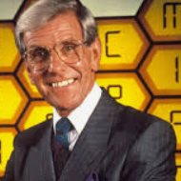
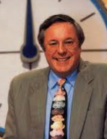
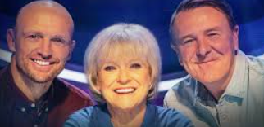
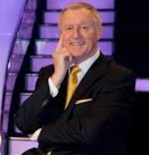
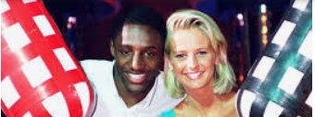
Round four : Guess the show
Guess the game show these individuals presented:
1.
2.
3.
4.
5.
6.
Notes:
Please add the theme to the header of the quiz.
You should aim to have around 5 minutes for each round so consider this for when thinking of questions for the quiz. Try to vary the difficulty level of questions to make it more interesting for participants.
Ask participants if they would like you to repeat any questions from this round.

Slide 7
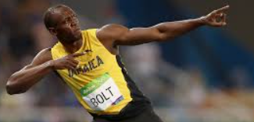
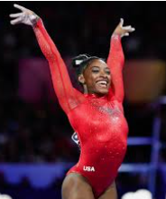
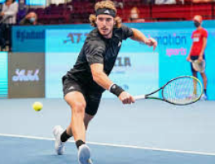
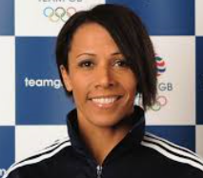
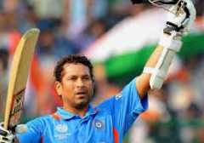
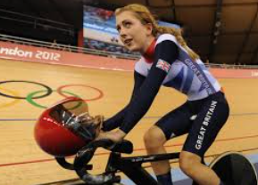
Round five: Sports
Name each individual:
1.
2.
3.
4.
5.
6.
Notes:
Please add the theme to the header of the quiz.
You should aim to have around 5 minutes for each round so consider this for when thinking of questions for the quiz. Try to vary the difficulty level of questions to make it more interesting for participants.
Ask participants if they would like you to repeat any questions from this round.
Once you have run through all of the questions, go to Slide 4 to reveal the answers to the groups. Encourage people to shout out the answers or write them in the chat before you confirm the answers.
When you have gone through all of the question ask participants to add up their scores, read them out one by one (or in the chat box) so you can reveal the winner!

Slide 8
Answers
Round one: Instruments
Saxophone
Trombone
Tambourine
Cello
Harmonica
Round two: Geography
Venezuela
River Seine
Wellington
Mount Everest
Antarctica
Three
Notes:
Please add the theme to the header of the quiz.
You should aim to have around 5 minutes for each round so consider this for when thinking of questions for the quiz. Try to vary the difficulty level of questions to make it more interesting for participants.
Ask participants if they would like you to repeat any questions from this round.
Once you have run through all of the questions, go to Slide 4 to reveal the answers to the groups. Encourage people to shout out the answers or write them in the chat before you confirm the answers.
When you have gone through all of the question ask participants to add up their scores, read them out one by one (or in the chat box) so you can reveal the winner!

Slide 9
Answers
Round three: Brands
Coca-Cola
Adidas
Microsoft
Lidl
Nandos
Zoom
Round four: Guess the show
Blockbusters
Countdown
Question of Sport
Who Wants To Be A Millionaire?
Gladiators
Notes:
Please add the theme to the header of the quiz.
You should aim to have around 5 minutes for each round so consider this for when thinking of questions for the quiz. Try to vary the difficulty level of questions to make it more interesting for participants.
Ask participants if they would like you to repeat any questions from this round.
Once you have run through all of the questions, go to Slide 4 to reveal the answers to the groups. Encourage people to shout out the answers or write them in the chat before you confirm the answers.
When you have gone through all of the question ask participants to add up their scores, read them out one by one (or in the chat box) so you can reveal the winner!

Slide 10
Answers
Round five: Sports
Usain Bolt
Simone Biles
Stefanos Tsitsipas
Kelly Holmes
Sachin Tendulkar
Laura Kenny
Notes:
Please add the theme to the header of the quiz.
You should aim to have around 5 minutes for each round so consider this for when thinking of questions for the quiz. Try to vary the difficulty level of questions to make it more interesting for participants.
Ask participants if they would like you to repeat any questions from this round.
Once you have run through all of the questions, go to Slide 4 to reveal the answers to the groups. Encourage people to shout out the answers or write them in the chat before you confirm the answers.
When you have gone through all of the question ask participants to add up their scores, read them out one by one (or in the chat box) so you can reveal the winner!

Slide 11
Thank you for participating! ☺

